Slide 1
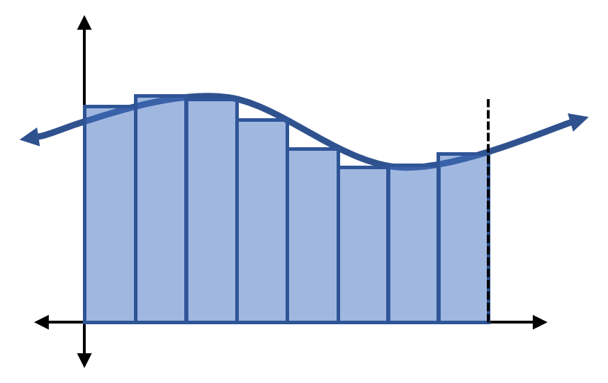

Slide 3


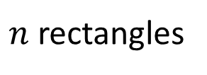
$n$ rectangles
$$b$$
$$a$$

Slide 5
Speed
Time

